Slide 1


Updates
Olivier Bergeron

Slide 2

Since last time
Two main goals
1- Keep searching for articles for correlation between electrode count and classification accuracy
Didn’t find any more valuable article as of right now
2- Find more articles about motor unit decomposition

Slide 3
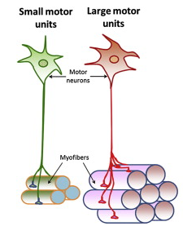
Motor Unit
Definition: A motor unit consist of a motor neuron and all the muscle fibers innervated by the axon.
Smallest functional unit of voluntary muscle activation
S. K. Gollapudi, J. J. Michael, and M. Chandra, Striated Muscle Dynamics, Reference Module in Biomedical Sciences. Elsevier, 2014. doi: 10.1016/B978-0-12-801238-3.00251-8.

Slide 4
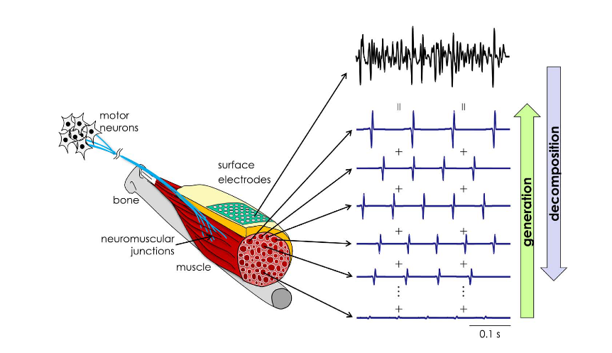
Motor unit vs EMG
D. Farina et A. Holobar, « Characterization of Human Motor Units From Surface EMG Decomposition », Proc. IEEE, vol. 104, nº 2, p. 353‑373, févr. 2016, doi: 10.1109/JPROC.2015.2498665.

Slide 5
Motor Unit Decomposition
Multiples techniques for extracting motor units spike trains
Blind Source Separation
Separates mixed signals into their original independent sources without prior knowledge of the mixing process.
Convolution Kernel Compensation
Reconstructs motor unit spike trains by compensating for the convolution effect of motor unit action potentials in EMG signals.
Template matching + clustering
Detects and classifies recurring signal patterns (spikes) by comparing them to learned templates and grouping similar ones into clusters.

Slide 6
What information can be extracted
Firing rate of motor units
Recruitment order
Spike timing
Spatial location

Slide 7
Pros with motor unit decomposition
Ability to find subtle gestures
Some EMG patterns overlap for different motor unit activity
High quantity of recognisable gestures with high classification accuracy
Example of quantity of gestures: 12 (94.6%)¹, 66 (≥ 89%)²
High classification accuracy
Around the same as CNN
[1] C. Chen, Y. Yu, X. Sheng, J. Meng, et X. Zhu, « Real-Time Hand Gesture Recognition by Decoding Motor Unit Discharges Across Multiple Motor Tasks From Surface Electromyography », IEEE Trans. Biomed. Eng., vol. 70, nº 7, p. 2058‑2068, juill. 2023, doi: 10.1109/TBME.2023.3234642.
[2] M. Montazerin, E. Rahimian, F. Naderkhani, S. F. Atashzar, S. Yanushkevich, et A. Mohammadi, « Transformer-based hand gesture recognition from instantaneous to fused neural decomposition of high-density EMG signals », Sci Rep, vol. 13, nº 1, p. 11000, juill. 2023, doi: 10.1038/s41598-023-36490-w.

Slide 8
Cons with motor unit decomposition
Highly sensitive to electrode shift
Often required to re-decompose the motor units when shifting happens
More “hardware hungry”
Decompositions methods are more computationally intensive
More power is needed
Very difficult for real-time application
Highly sensitive to positioning
Misalignments/changes in contact degrades motor unit tracking quality
When redonned, recalibration is required

Slide 9
What if: hybrid method
Hybrid method: Combine motor unit decomposition with CNN features
Why?
Robustness, fast computing and general hand gestures with CNN
Fine neural control details with motor unit decomposition

Slide 10
What if: hybrid method
Methods examples
Early fusion: Concatenate EMG + Motor Unit into one input
Late fusion: Two separate classifier fused at decision level
Joint fusion: Models with dual-branches and adaptive weighting
Applications
High gesture count applications
Benchmarking upper limits of classification performance

Slide 11
Pros and Cons
Pros
Combining increase accuracy
More gesture recognition
Can give neural control information
Cons
High computing cost
Very hard for wearable devices
High sensibility with steep performance reduction risk

